Slide 1

St. Francis Institute of Technology
Information Technology
IoE Mini Project (ITL802)
Flood Detection System
Lavia Suvarna 64
Shweta Pai 65
Malcolm D’souza 66
Mentor
Dr. Prachi Raut

Slide 2
Overview
Introduction
Literature review
Problem statement
System design and requirements
Circuit diagram
Data analytics
Results
Conclusion
Future Scope
References

Slide 3
Introduction
IoE is the intelligent connection of people, process, data and things. The Internet of Everything (IoE) describes a world where billions of objects have sensors to detect, measure and assess their status; all connected over public or private networks using standard and proprietary protocols.
The domain of our project is disaster management which involves mitigation, preparedness, response, relief and recovery. Floods cause damage to human lives, property and cause extensive losses to a society.
To this problem we have proposed a solution where we can detect the floods before it takes place and analyze the water levels with respect to time using the LSTM algorithm.

Slide 4
Literature Review
Sr. No. | Title | Summary | Gaps Identified
[1] | Design of river height and speed monitoring system by using Arduino.(2018) | In this paper, a system is designed to measure the altitude and speed of the river. In this work Arduino Uno, ultrasonic sensors and flow rate sensors are used. Ultrasonic sensor HC-SR04 is used as a river height meter. Based on the test results the accuracy of the sensor is calculated. | There is no analysis or predictions done in this system. Only sensor accuracy is calculated.
[2] | Design of Automatic Water Flood Control and Monitoring Systems in Reservoirs Based on Internet of Things (IoT) (2020) | The IoT on this prototype is used for real-time control and monitoring of water levels by using a web server as an interface. The components used consist of ESP 32 micro-controller, ultrasonic sensors for reading water level data and stepper motor actuators to control sluice gates with 3 water level conditions: low, medium, high. | Lack of prediction or algorithm used for analyzing the data on the server. Analysis is focused on the stepper motor readings and not flood detection.

Slide 5
Literature Review
[3] | Fuzzy Logic-Based Flood Detection System Using Lora Technology.(2020) | The system consists of two parts which are, the branch nodes and the main controller. The branch nodes send soil moisture and surface runoff data of its surrounding environment, to the main controller. The system uses LoRa communication signals for communication in which the outputs are flood consequence and flood probability. The product of these two will produce the flood risk in percentage. | Battery supply is provided which can last only for 4 months.
[4] | Flood Monitoring System Using IoT and Machine Learning.(2020) | The system is developed using a Raspberry Pi, camera to detect the rising water level. We employ image processing, edge detection and prediction methods to detect the rising water level and predict the time of impact. | Cost to develop the system is very high as compared to our system, also the high level of computing and processing required as images need to be cleaned before performing any analysis.

Slide 6
Literature Review
[5] | An IoT-BasedRain Alerting and Flood Prediction using Sensors and Arduino for Smart Environment.(2018) | The sensors collect data from the environment and store in a form of a csv file on a local storage using Tera Term. The users are notified in a form of SMS, and Buzzer. The stored data were analyzed using a Multilayer perceptron to predict floods with Weka. This proposed system uses the data from the local environment, stores it in local storage and performs the analysis. | No internet connectivity, though there is analysis and predictions, the data can’t be analysed online.
[6] | Early Flood Detection and Alarming System Using Machine Learning Techniques.(2020) | Predicting the upcoming floods on the basis of rainfall and current water levels would surely help in forestalling the large-scale life and property damages incurred due to the floods. In this paper they have experimented with different ML algorithms like SVM, KNN, Logistic Regression, Naive Bayes, etc., for the available rainfall dataset. | Real-time data is not used.

Slide 7
Problem Statement
In this project, the objective is to sense the water levels at river beds.
Here we are using an ultrasonic sensor to sense the river levels and a NodeMCU ESP8266 to process these data. The data is uploaded to ThingSpeak IoT cloud, using which the river levels are graphically monitored from anywhere in the world.
We have collected the data from the object and store it on the cloud and retrieve it in a csv format. This data is then used for analysis. The algorithm used is Long Short -Term Memory (LSTM) for future water level prediction.

Slide 8
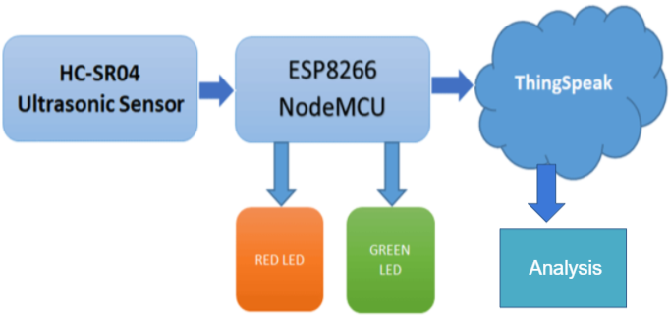
System Design
Output of LSTM Algorithm shown
on Google Collab

Slide 9
System Requirements
 | Hardware Requirements
1 | ESP8266 NodeMCU
2 | Ultrasonic Sensor
3 | Power Supply
4 | LEDs(Red & Green)
5 | Breadboard
6 | Jumper Wires
 | Software Requirements
1 | Thinkspeak cloud
2 | Google Collab
3 | Arduino IDE

Slide 10
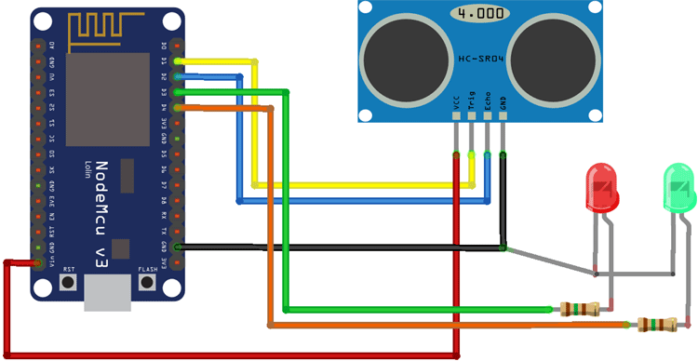
Circuit Diagram

Slide 11
Data analytics
We have developed a model which predicts the flood occurrence.
The parameters considered are water level and number of records (date and time).
The algorithm used is Long Short -Term Memory (LSTM). In this future water level is predicted using the past recorded data.

Slide 12
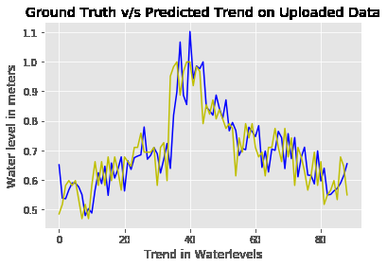
Results

Slide 13
Results
Our Dataset had about 50000 plus records and divided the data into two file one is seen and other is unseen.
The seen data was split into 70% train and 30% test and built a model using LSTM algorithm .
The accuracy is 95.03% for training and 97.97% for testing.
The unseen data we used for prediction of water level vs trends in water level i.e. the future records w.r.t. time.
The graph above shows the predicted water levels along with the actual water levels (ground-truth).

Slide 14
Conclusion
Flood is a major known natural disaster that causes a huge amount of loss to the environment and living beings. So in these conditions, it is most crucial to get the emergency alerts of water level status at river beds in different conditions.
Our project will provide real-time analysis of floods and help the locality to take necessary preventive measures.

Slide 15
Future Scope
Further improvisation can me done for this system wherein various other factors can be considered in the analysis like Geographic Area, Speed of river water flow, location, etc.

Slide 16
References
[1] T H Nasution, E C Siagian, K Tanjung, Soeharwinto, “Design of river height and speed monitoring system by using Arduino”, 2018 Department of Electrical Engineering, Universitas Sumatera Utara, Medan, Indonesia.
[2] Yuliarman Saragih, Jandoni Horas Prima Silaban, Hasna Aliya Roostiani, Agatha Elisabet S, “Design of Automatic Water Flood Control and Monitoring Systems in Reservoirs Based on Internet of Things (IoT)”, 2020 3rd International Conference on Mechanical, Electronics, Computer, and Industrial Technology (MECnIT).
[3] Choo Kam Khuen, Alireza Zourmand, “Fuzzy Logic-Based Flood Detection System Using Lora Technology”, 2020 16th IEEE International Colloquium on Signal Processing & its Applications (CSPA 2020), 28-29 Feb. 2020, Langkawi, Malaysia.

Slide 17
References
4] Mukul Lakhotia, Kushagra Goyal, Karan Pamnani, Lokesh Malviya, “Flood Monitoring System Using IoT and Machine Learning”, International Journal of Computer Techniques -– Volume 7 Issue 3, June 2020.
[5]Ayana Olika Kitil, Meeta Kumar, “An IoT-BasedRain Alerting and Flood Prediction using Sensors and Arduino for Smart Environment”, International Journal of Pure and Applied Mathematics Volume 118 No. 24 2018
[6] Pooja Mane, Meghana Katti, Preeti Nidgunde, Anil Surve, “Early Flood Detection and Alarming System Using Machine Learning Techniques”, International Journal of Research in Engineering, Science and Management Volume-3, Issue-10, October-2020

